Slide 1
Develop of a Text-To-Rap system
Deep Learning for Audio Signal Processing Final Project
Pablo Marcos Manchón

Slide 2
Table of contents
Previous work
Objective
Data collection
Data processing
Training TTS
Sentence align
Comparison

Slide 3
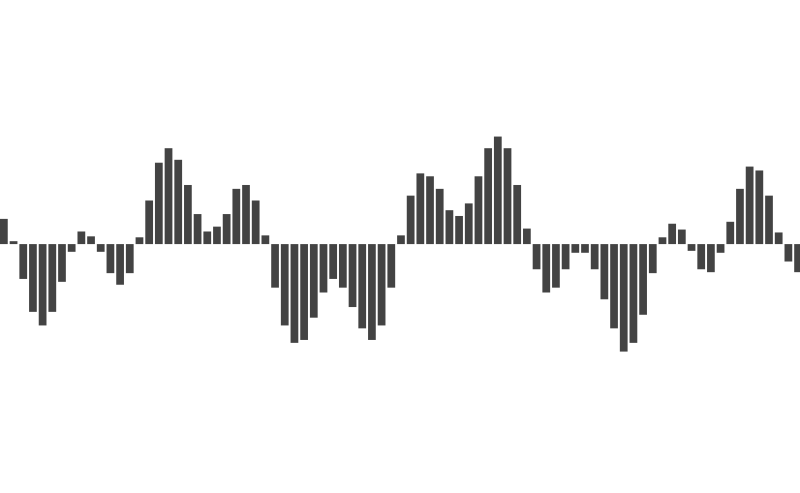
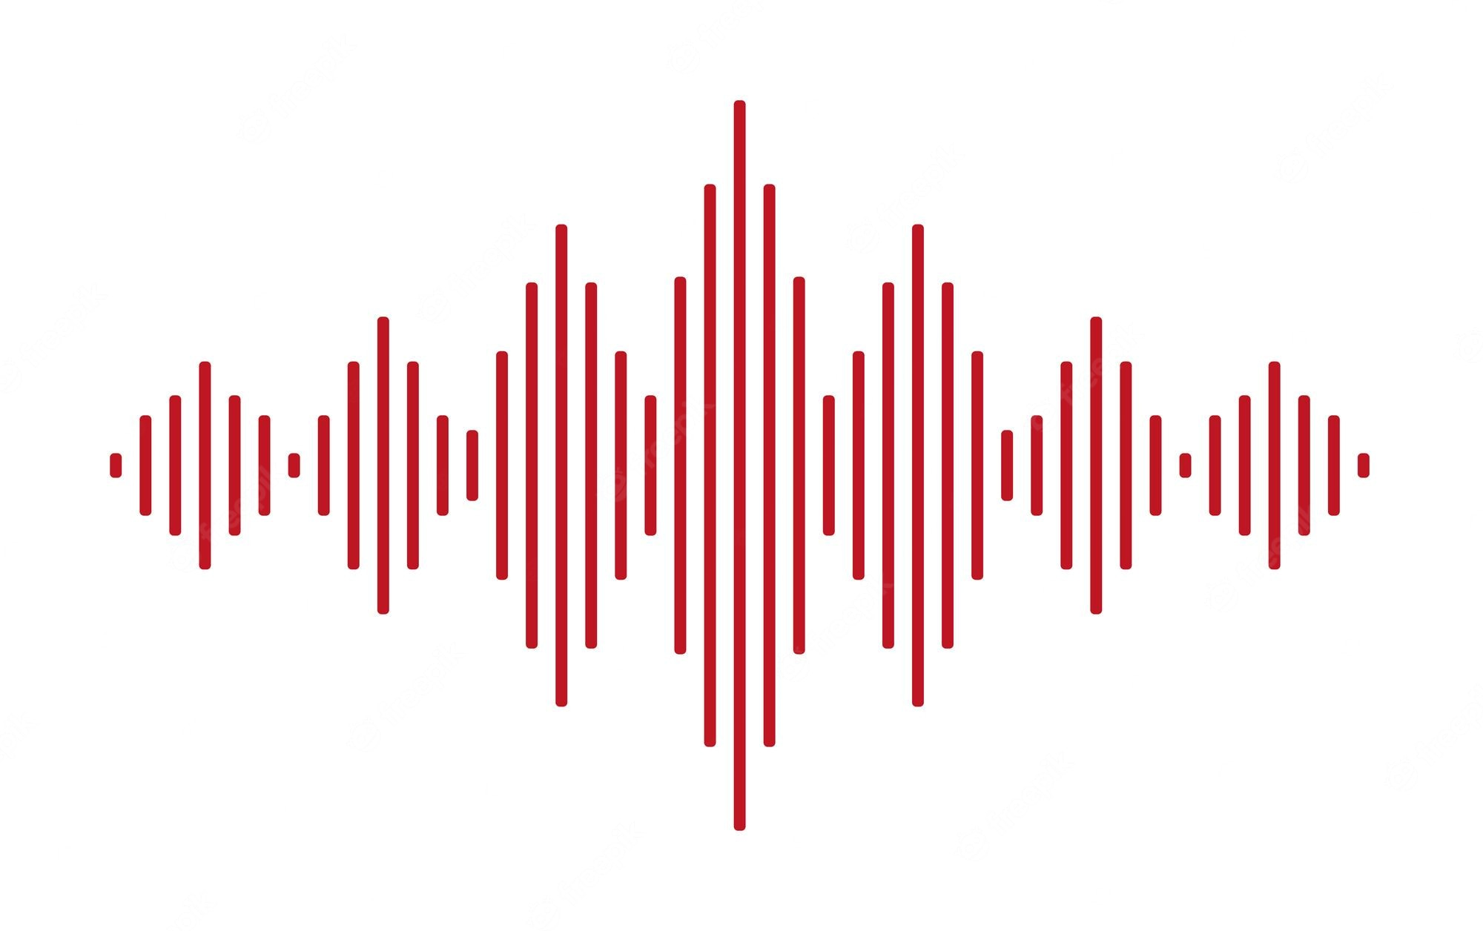
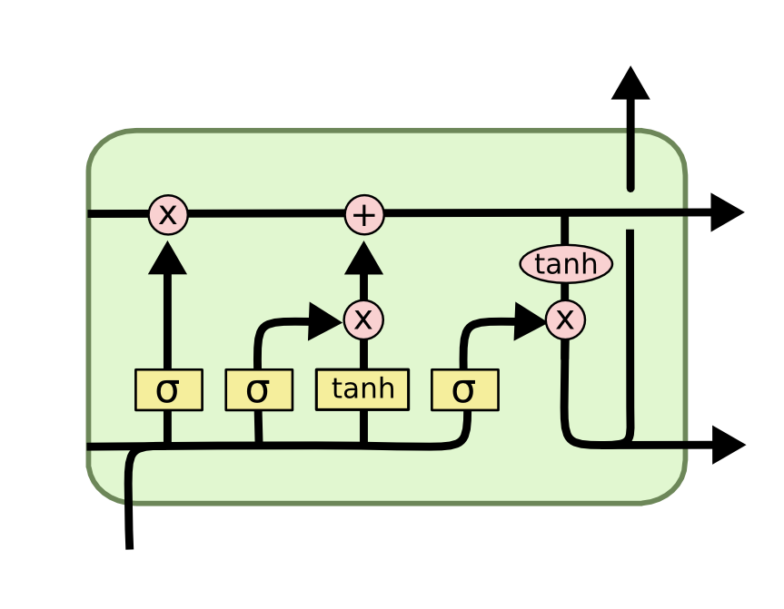


1. Previous work
1
2
3
4
Idea to continue final work of the Neurocomputing course [1]. Development of a rap lyrics generation system.
We downloaded a 30Mb corpus of text with song transcriptions.
Use of an LSTM for text generation
Use of google voice to read the song
Basic adjustment of the voice, the first syllable of each sentence was aligned with the beat 0.5 of every 4 bars.
Examples:
3. Join base + basic alignment
2. Text-to-Speech with google voice
1. Text generation
[1] Use of a recurrent neuronal network to automatically generate rap music in Spanish. Jorge Arellano y Pablo Marcos. GitHub.

Slide 4
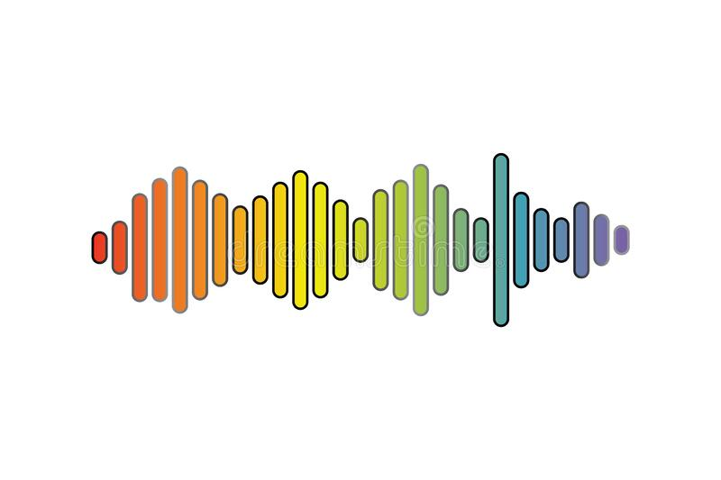

2. Objective
Improving the Text-To-Speech system of the previous architecture.
Try to develop a less robotic voice.
Improve alignment of the voice with the base.
Try to use deep learning techniques for audio whenever possible, even if there are simpler solutions.
Do not infringe any copyright.
Limitations:
Colab available resources.
No prior data: need to create dataset from scratch.
No idea about TTS.
Do it during the December long weekend.
?

Slide 5









3. Data collection
Use of Nach's discography. Key rapper in the evolution of the Spanish rap.
He usually sings alone
Style without major changes over the course of his career
No major variations in intonation, more rhythmic style, as if he were reciting poetry.
Very recognizable flow and timbre
Discography from 1994 - 2020
For the dataset I downloaded 8 albums and 5 singles. A total of 117 songs. Around 9 hour of music.
A bunch of challenges: Music and speech together, different speeds and emotions, other artists, parts without speech, different qualities, voice effects, etc.
El Idioma de los dioses (2011)
Me llaman (2014)

Slide 6
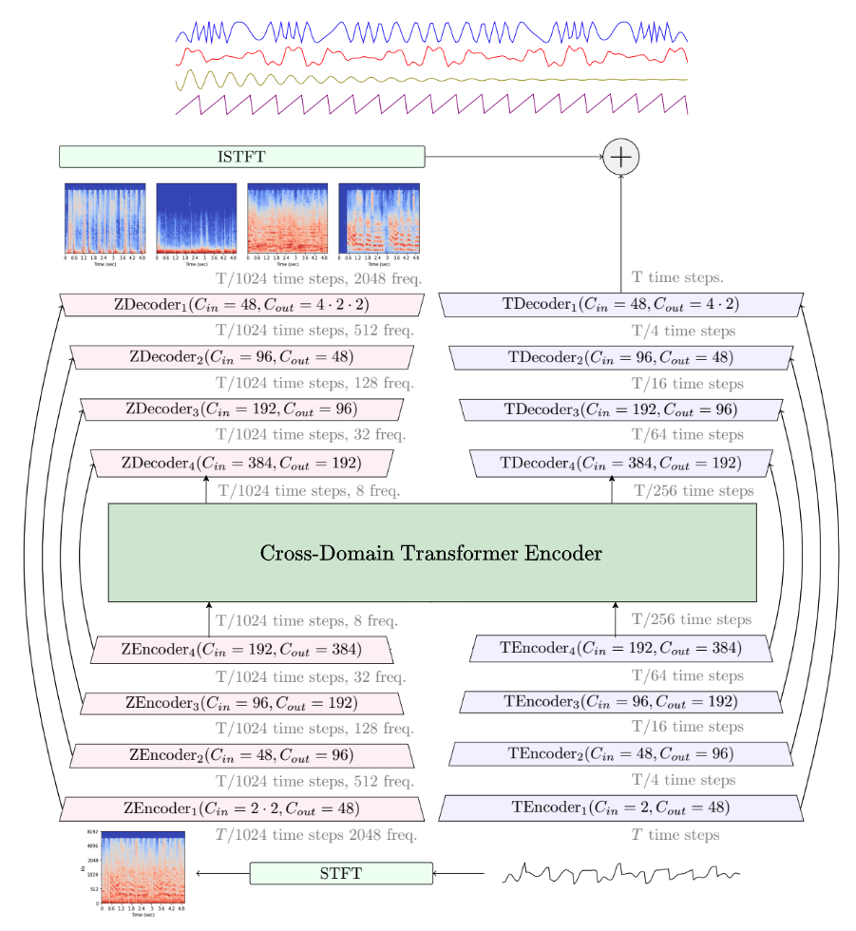
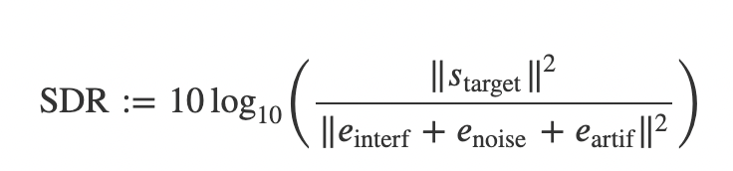
4. Data processing
4.1 Music Source Separation
Objective: To separate the voice from the music and the rest of the elements of the songs.
Use of Hybrid Transformer Demucs v4, released by Facebook Research in Nov 2022 (GitHub).
Achieve state-of-the-art in source separation, 9.20 dB of SDR (Source-to-Distortion Ratio).
I used it to separate the 117 songs into 4 parts: vocals, drums, bass, other.
Hybrid Demucs architecture
Hybrid Spectrogram and Waveform Source Separation. Alexandre Défossez. https://arxiv.org/pdf/2111.03600.pdf

Slide 7
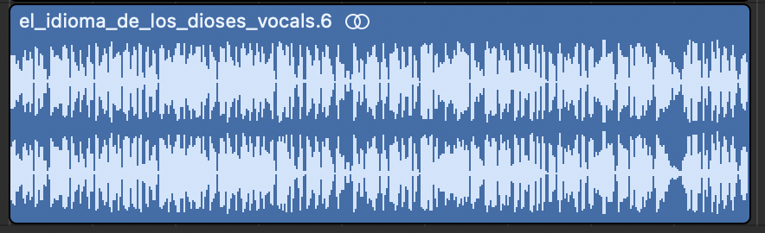
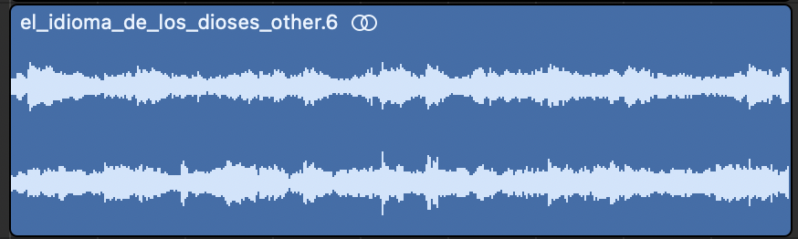

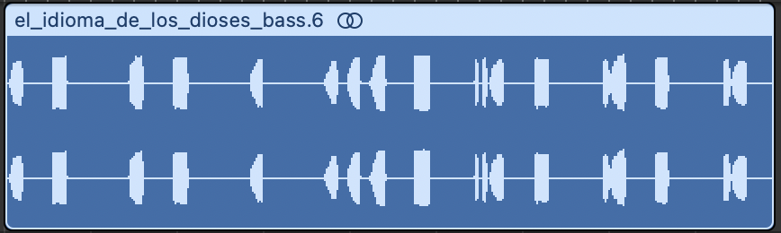
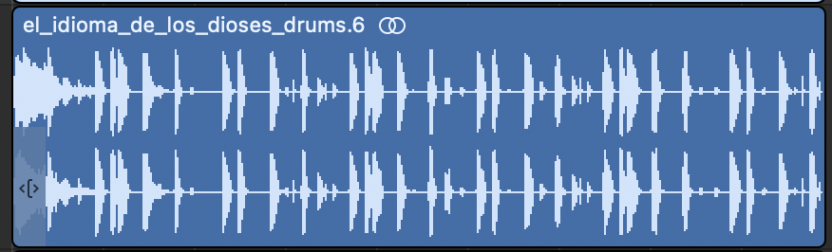
4. Data processing
4.1 Music Source Separation - Example
Near-perfect results in almost all situations, even with loud background music
Even with voices with effects: dubbed voices, chorus, reverb, etc.
Issues: Some songs include vocals on the bases, multiple singers, etc.
Vocals
Other
El Idioma de los dioses
(2011)
Bass
Drums

Slide 8
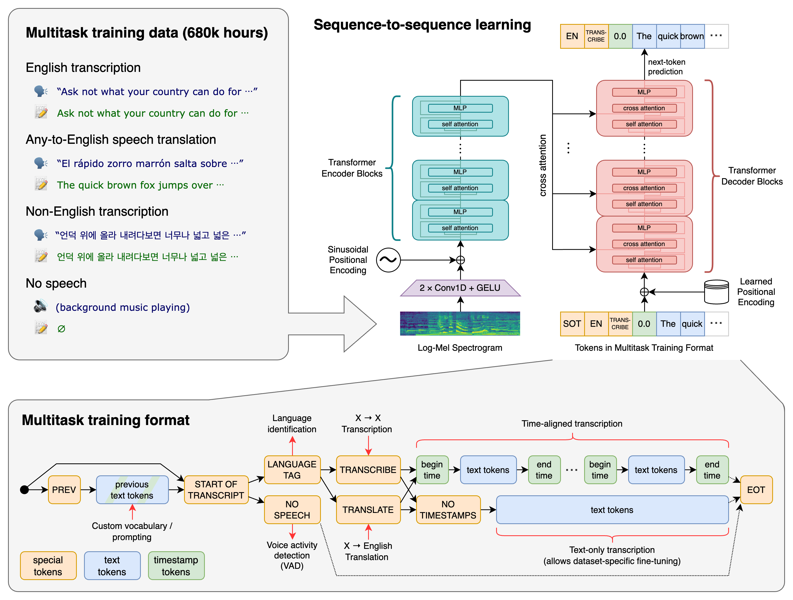
4. Data processing
4.2 Speech Transcription
Use Whisper to transcribe all the vocals tracks separated in the last stage.
Model released by OpenAI in Sept. 2022 (GitHub)
SOTA results for general purpose speech-to-text transcriptions
I generated transcriptions for the 117 songs with timestamps at a sentence level
Use of model “large” due to the complexity of the speech (fast, strange words, voice effects, etc).
Robust Speech Recognition via Large-Scale Weak Supervision.
Alec Radford, Jong Wook Kim, Tao Xu, Greg Brockman, Christine McLeavey, Ilya Sutskever. https://cdn.openai.com/papers/whisper.pdf
Whisper architecture

Slide 9

4. Data processing
4.2 Speech Transcription - Example
1.12 9.52
Oh, el gran Nach, Tito, Falsa Alarma, Mano con mano, es el club de los olvidados.
9.52 15.28
Alza la vista más allá del barrio, intenta abrir los ojos y sate el ruido diario, por favor.
15.28 20.44
Objetos materiales en tu armario a los que no les das valor, vida fácil la del ágil vencedor.
El club de los olvidados.
Poesía difusa (2003)
Nach, Falsalarma

Slide 10
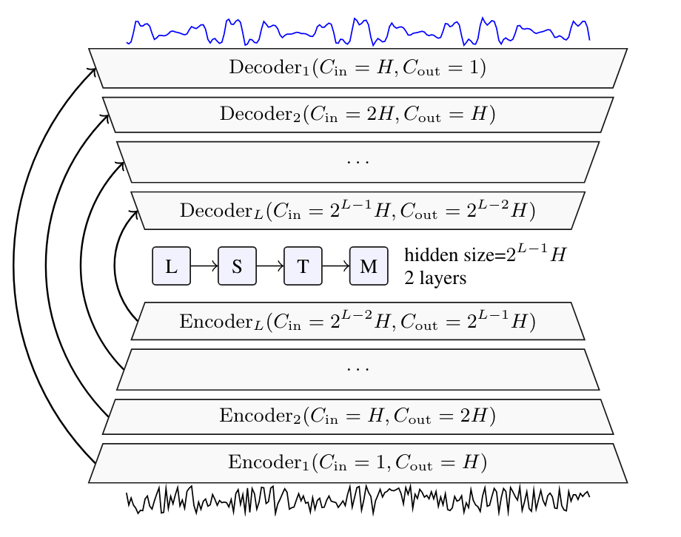
4. Data processing
4.3 Denoising
Denoise the vocal audios to improve the results (better audio quality will imply better TTS system).
Use of Real Time Speech Enhancement in the Waveform Domain, Interspeech 2020 (Github).
Step finally discarded.
Not trained to remove noise like the one in our audio tracks (base voices).
Other denoisers have been tried without good results.
Maybe, a speaker separator would be needed
Example of noisy audio:
Denoiser architecture
Real Time Speech Enhancement in the Waveform Domain.
Alexandre Defossez, Gabriel Synnaeve, Yossi Adi.
https://arxiv.org/abs/2006.12847

Slide 11
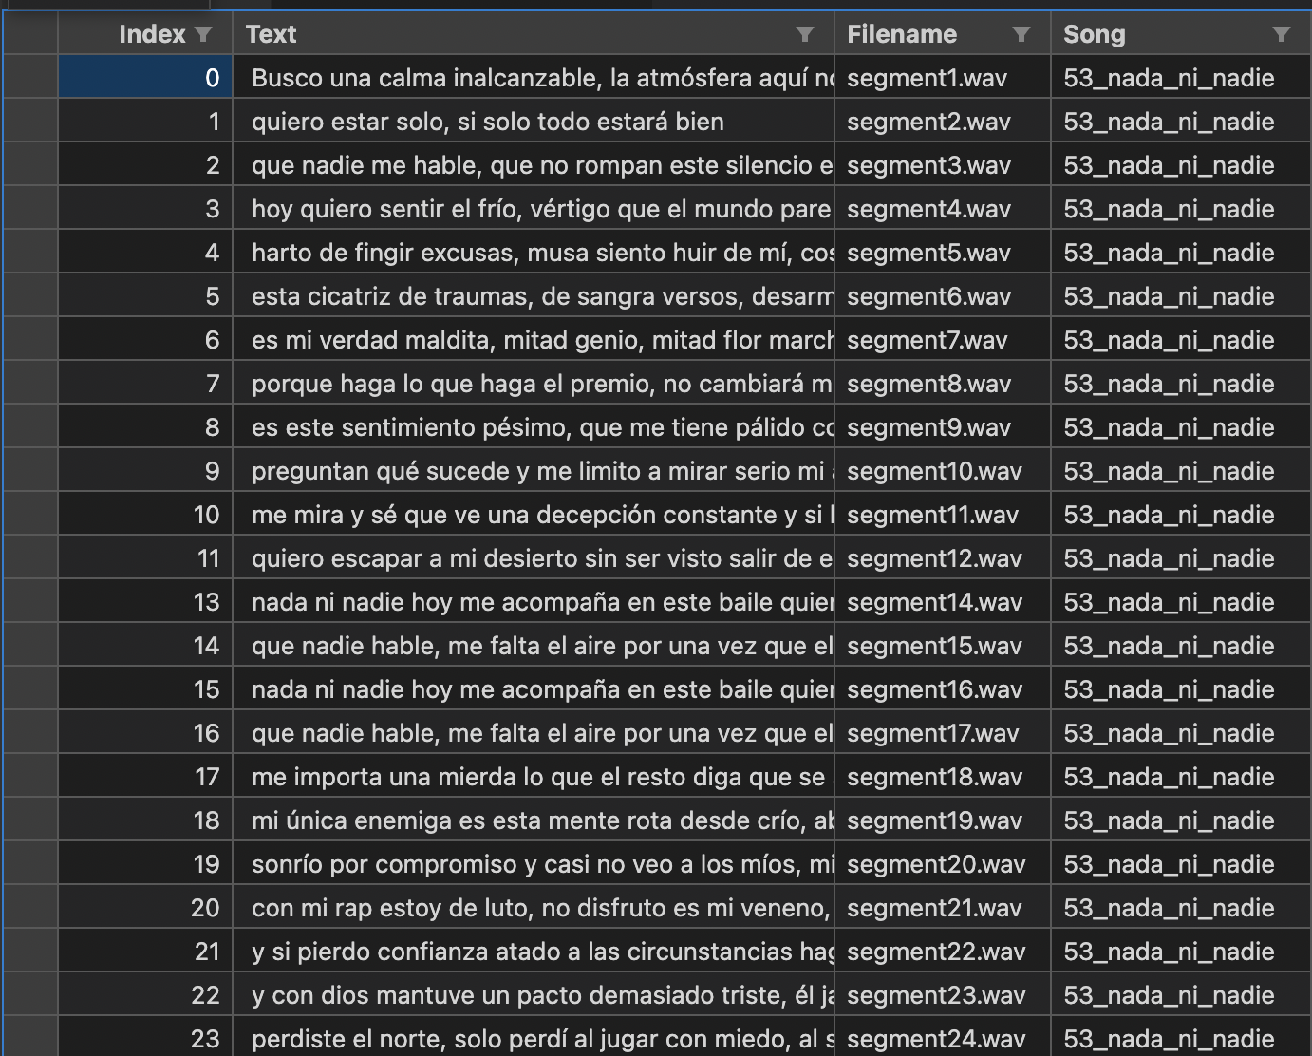
4. Data processing
4.4 Segment cutting
Cut tracks with vocals of all songs into segments for further training of the system
Use of timestamps per phrase provided by whisper
Creation of a file associating each audio fragment with its text
In total 9.055 sentences with 7.42 hours of speech
Example:
Text: “Busco una calma inalcanzable, la atmósfera aquí no es fiable”
Filename: segment1.wav

Slide 12
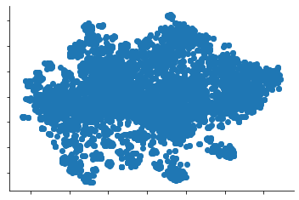
4. Data processing
4.5 Speaker identification
The audio excerpts contain phrases from multiple singers
Phrases with wrong cuts, including unvoiced parts
Use of Deep Speaker architecture (GitHub) to eliminate erroneous segments.
Calculation of a speaker vector for each segment (extracting it from an embedding layer of the architecture of size 512).
Use of cosine similarity to measure the distance between segments.
At a glance, we can see clusters in the embeddings.
TSNE of the segment embeddings
Deep Speaker: an End-to-End Neural Speaker Embedding System
Baidu Inc. https://arxiv.org/pdf/1705.02304.pdf

Slide 13
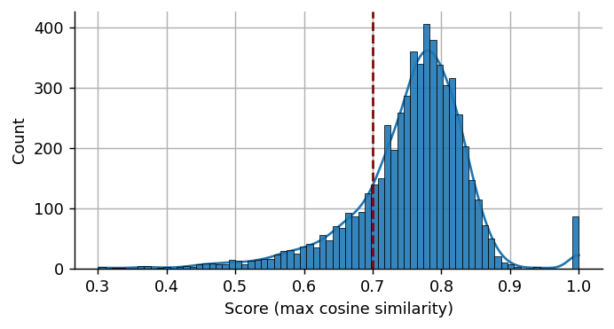
4. Data processing
4.5 Speaker identification - Filtering
I selected reference phrases randomly (chosen manually).
The distances to the reference segments have been calculated.
Filtered all those segments with distance less than 0.7
Phrases with less than 3 words have also been filtered.
If I were to repeat the experiment now I would be stricter, with a higher threshold and using more filter to detect too long sentences.
After the filtering: 5.992 segments.
Reference segments
Deep Speaker: an End-to-End Neural Speaker Embedding System
Baidu Inc. https://arxiv.org/pdf/1705.02304.pdf

Slide 14

4. Data processing
4.6 Recap – Weakly supervised pipeline
Transcription
Text
Sentence timestamps
Source separation
Cutting
Filter
segments
Songs
Speech
Segments
Segments with
transcriptions
+ select
references
Note: The selection of the reference segments could be done in a fully unsupervised way to make all the process automatic
Scoring
Bass, drums and base
Scores
14

Slide 15
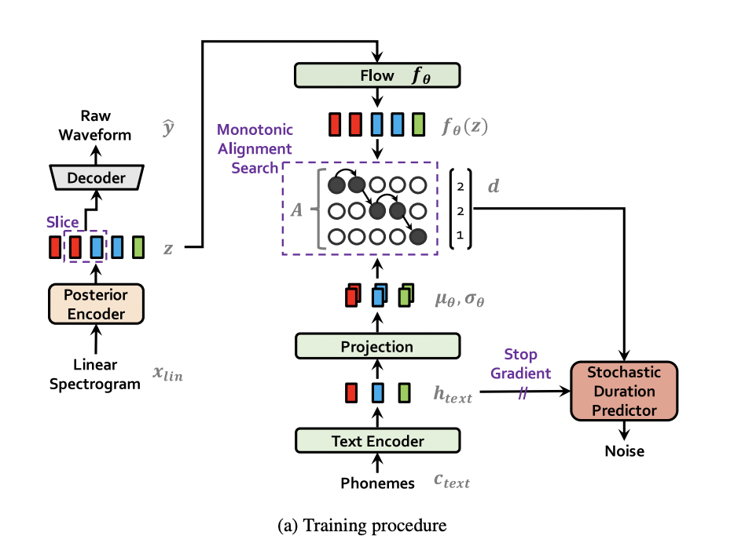
5. Training the TTS system
5.1 Model
There are tutorials to train systems with a voice, but all the ones I found were based on English or other languages (in English or Chinese phonemes generally).
Not enough computing resources to train a system from scratch
After much searching, I found a pre-trained model in Spanish in the library coqui-ai/TTS (model with name tts_models/es/css10/vits)
Pre-trained VITS model in Spanish based on a conditional variational autoencoder.
Trained with chars not phonemes
Conditional Variational Autoencoder with Adversarial Learning for End-to-End Text-to-Speech.
Jaehyeon Kim, Jungil Kong and Juhee Son
https://arxiv.org/pdf/2106.06103.pdf
VITS model procedure (training)

Slide 16
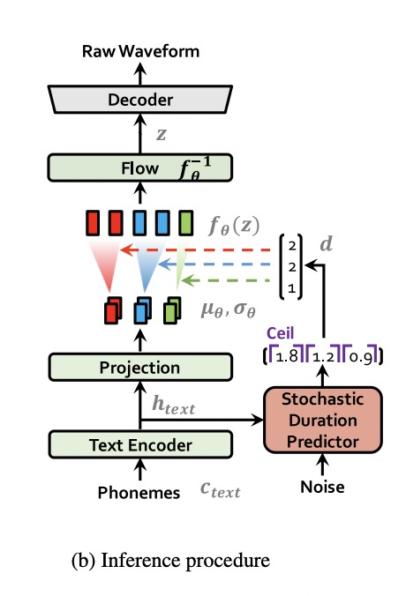
5. Training the TTS system
5.2 Fine-tune issues
Fine-tuning the model was a challenge:
No documentation for fine-tuning. Understand how the framework was intended without help
The Spanish model was not prepared for fine-tunning, the parameters used to create the model were not documented (I had to infer it from the PyTorch state dictionary).
The discriminator network weights were not stored (only the part for inference was stored)
Prepare the dataset to be in the same format (same text processing, speaker embedding managing, …)
Adjust learning rates (there was multiple in the architecture) taking into account the missing part of the network
Train for ~2 hours in Colab standard GPU
VITS model procedure (inference)
Model before fine-tunning
Model after fine-tunning

Slide 17
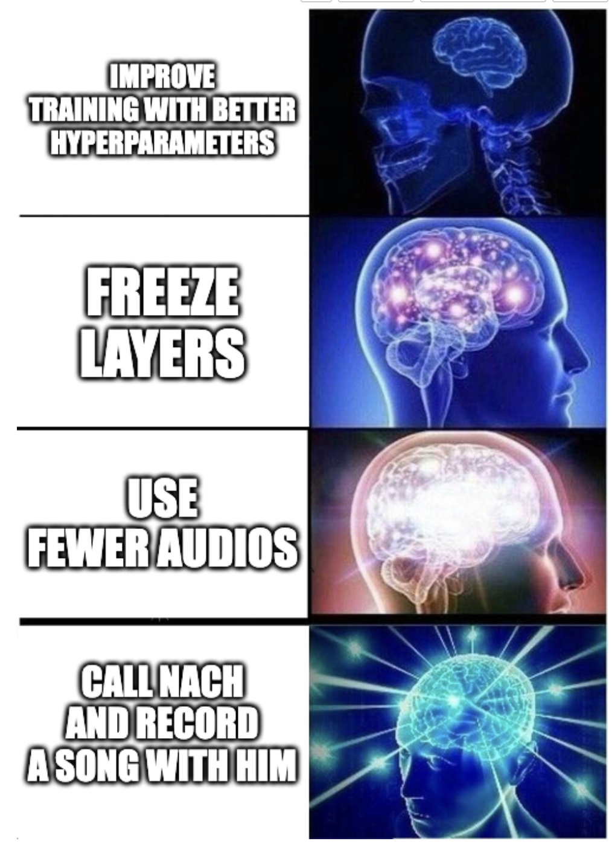
5. Training the TTS system
5.3 Things I learned and would change
I would use fewer audios, but from the same domain and better quality. As the generation of phrases is done independently, between phrases the model still shouts or is quieter and gives an irregular feeling. It could be retrained again with only 5-6 songs with a same style.
I would try to freeze layers for training, especially since the discriminator does not have pre-trained weights.
The network is very sensitive to the length of segments, it would filter out segments that are too long (many erroneous).
I would try to adjust the length of the sentences, the times given by whisper are not very accurate, when performing inference sometimes it cuts part of the first and last syllable as a result.

Slide 18
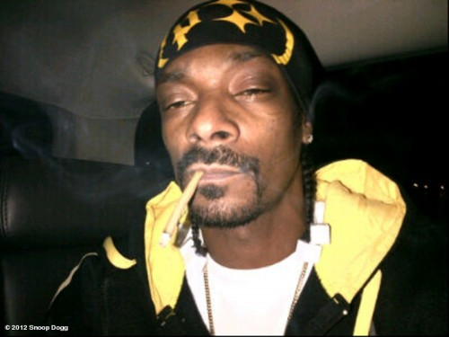
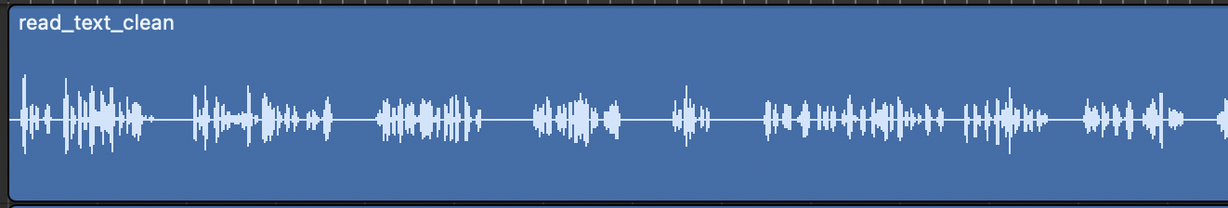
6. Aligning sentences
6.1 Testing the speech generation
First test of the system:
Take one of Nach's songs (Esclavos del destino)
Separate base and voice
Transcribe voice
4. Read song with TTS
5. Join with the base without any alignment.
Problem: The network has learned to generate sentences separately, but generates them independently. It is necessary to adjust the spacing between sentences.
The gaps between sentences can be seen in the waveform.
“Esclavos del desino” sing by TTS system without any aligment

Slide 19
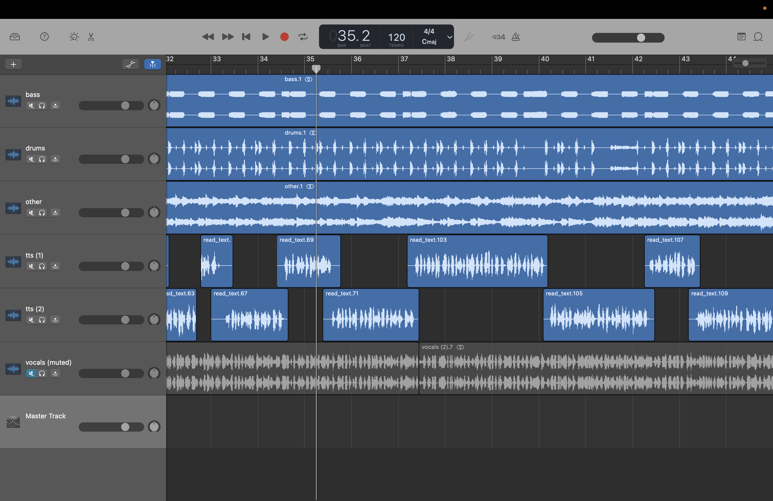
6. Aligning sentences
6.2 Manually aligment
The sentences are in rhythm. It is only necessary to adjust the spacing between them.
To test how the result would look like, I cut the spaces manually
No further transformations have been made (no warping, no echo, reverb, etc).
Result:
“Esclavos del destino - Nach” but readed
by TTS system and manually aligned. Cut.
19

Slide 20
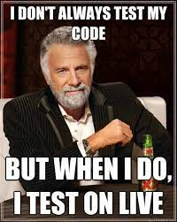
7. Live test
https://colab.research.google.com/drive/1T2ucPAtvb8sfPxFz8j_YOri3e8RpYd2N#scrollTo=fKOb70c2BoUT
20

Slide 21


The end?
21

Slide 22
Diapositivas descartadas, demasiado largo

Slide 23
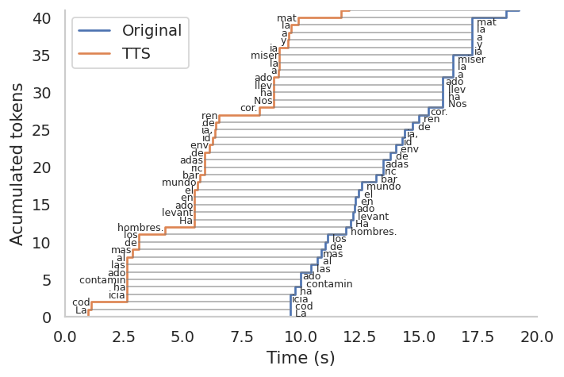
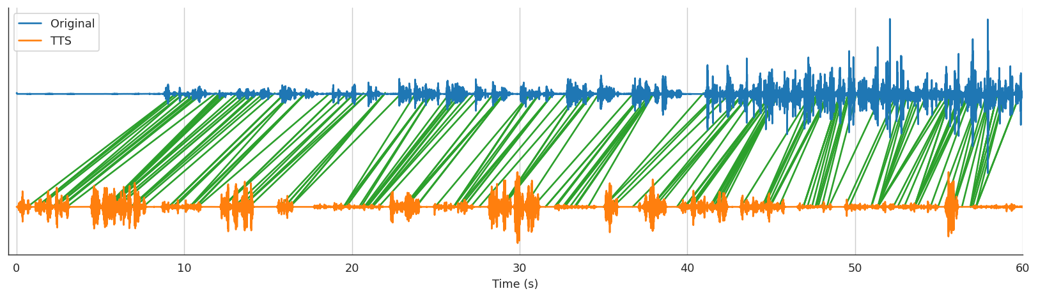
6. Aligning sentences
6.3 Use of whisper timestamps
Attempt to align automatically. Idea -> Copy the rhythm of a song and replace the voice.
Use a modified version of whisper when transcribing to obtain timestamps of tokens by extracting them from logits(Github).
Transcribes the original audio and the one read by the TTS.
Match both texts at the letter level by calculating substitutions, insertions, deletions(Myers’s bit-vector algorithm)
Use the result to match tokens
Use the timestamps of the tokens to have a time relationship between the audio read by the TTS and the original voice.
23

Slide 24
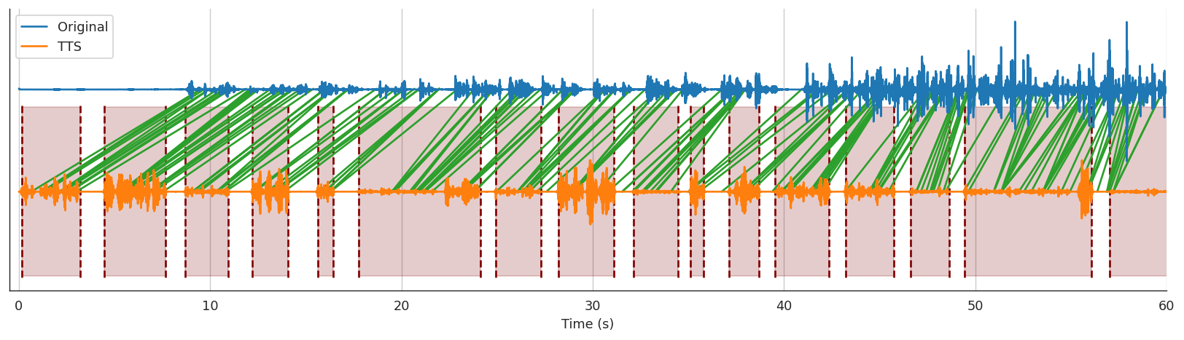
6. Aligning sentences
6.3 Shift blocks using landmarks
Align speech sentences using timestamp relations
1. Find speech windows (I did it using a window to look for the spaces and find the blocks carefully).
24

Slide 25
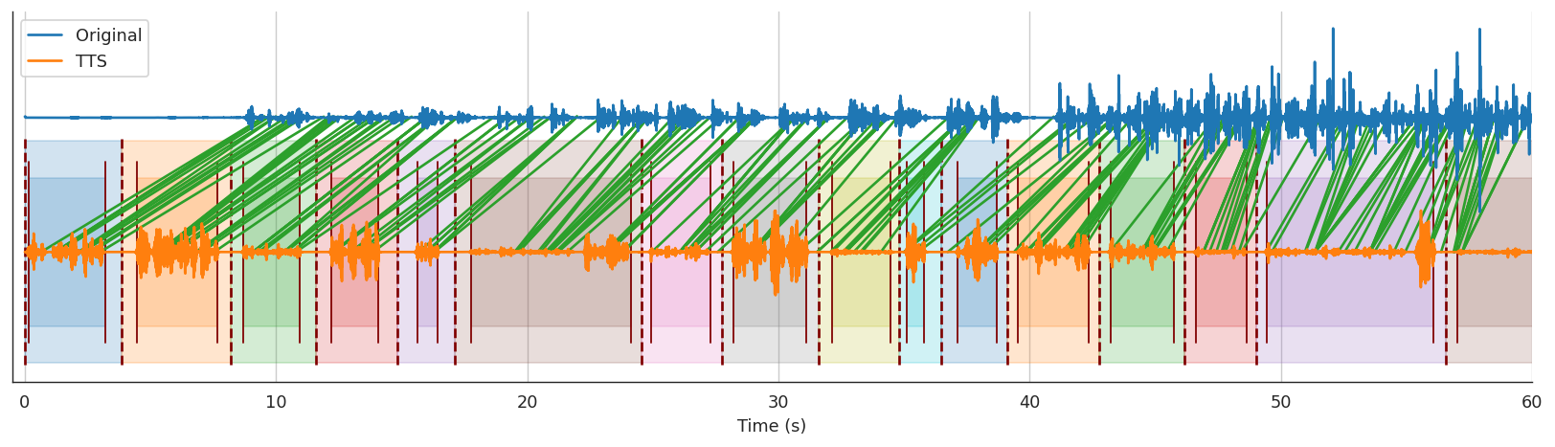
6. Aligning sentences
6.3 Shift blocks using landmarks
Align speech sentences using timestamp relations
2. Extend the widows to adjacent spaces to cover all the track
25

Slide 26
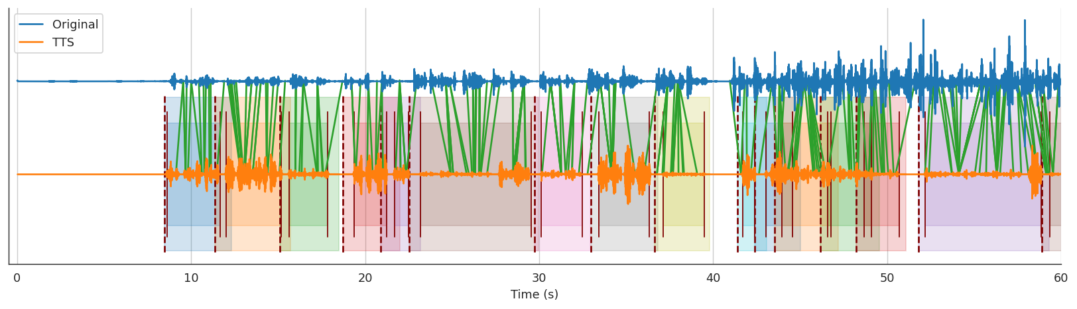
6. Aligning sentences
6.3 Shift blocks using landmarks
Align speech sentences using timestamp relations
3. Calculate the shift of each block (For example, use the mean distance between landmarks mean(xi-yi) to minimize the square distance) and merge the shifted blocks in a wav file (this part was very tricky, I had to code an algorithm to merge the waves taking care of the overlapping).
26

Slide 27
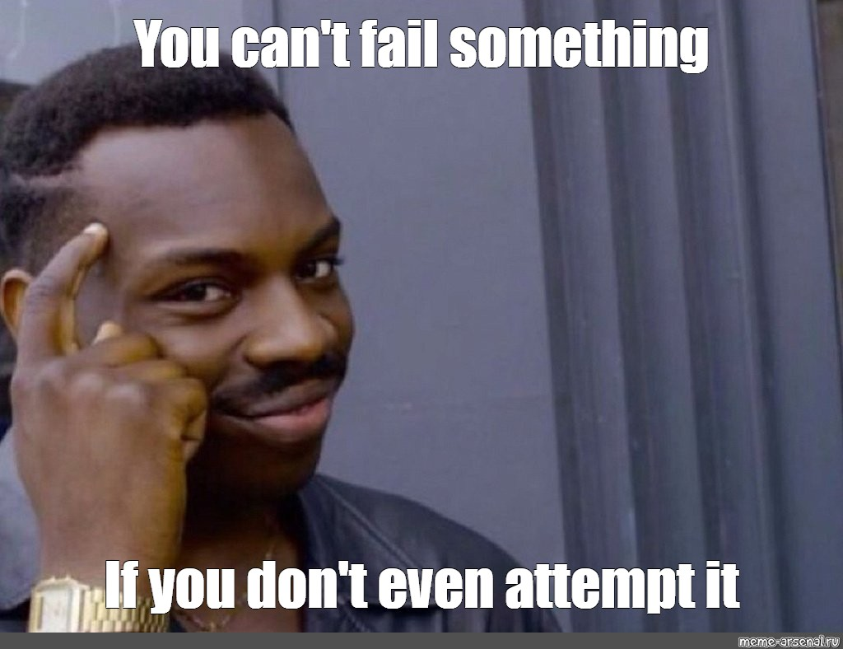
6. Aligning sentences
6.3 Shift blocks using landmarks
The results are not very good because Whisper’s token timestamps are not accurate (it is not intended for this purpose).
With good timestamps (force-alignment task) it could be possible to align the base with the voice with good results.
I have not investigated this line further, as to use it you need the landmarks of someone singing over it.
The algorithm of shifting blocks and joining them together can be very useful, we just need to calculate the displacement of each block. -> We will infer it from the beats.
27

Slide 28
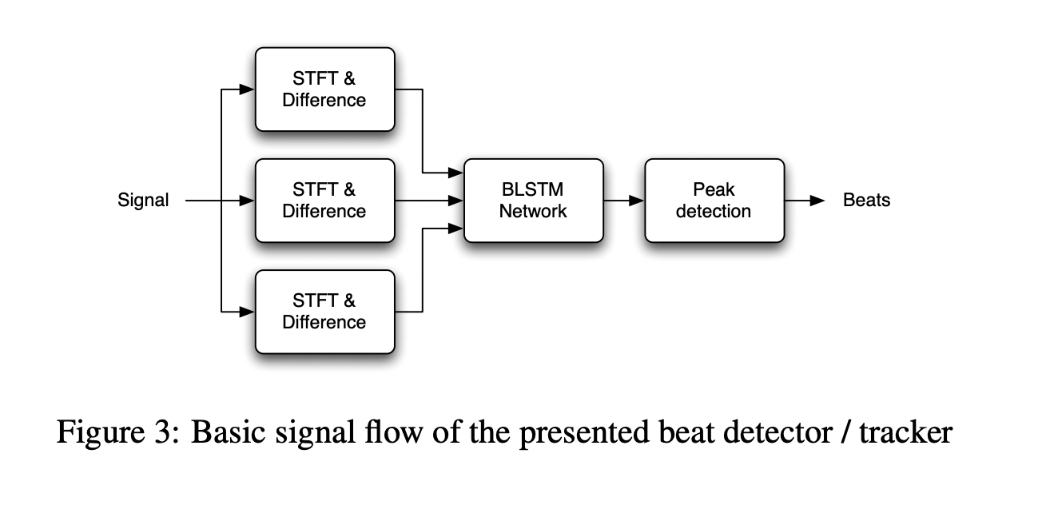
6. Aligning sentences
6.3 Automatic alignment based on beats – Find beats
First we need to find the base beats and then align the songs with the base.
It's easy, since in rap there are usually very marked drums and they are always edited from studio loops.
Generally there are never time changes, so the assumption that there is a global tempo is true.
Use of the beats detector based on RNNs from the madmon library (Github).
Example of a song fragment with the tempo detected by the model. Song Palabras (sing by the original Nach).
Sebastian Böck and Markus Schedl, “Enhanced Beat Tracking with Context-Aware Neural Networks”, Proceedings of the 14th International Conference on Digital Audio Effects (DAFx), 2011. http://recherche.ircam.fr/pub/dafx11/Papers/31_e.pdf
28

Slide 29
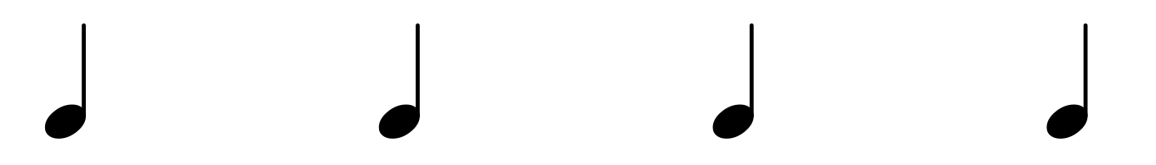
6. Aligning sentences
6.3 Recap – Basic aligment based on beats
Rap TTS
Cut into blocks
Text
Speech blocks
Speech
Basic mixer
Automatic
Rap
Rap base
Beat detector
Room for improvement, perhaps a learned approach? Generate multiple versions of each sentence and select the best?
Beats
29

